Slide 1
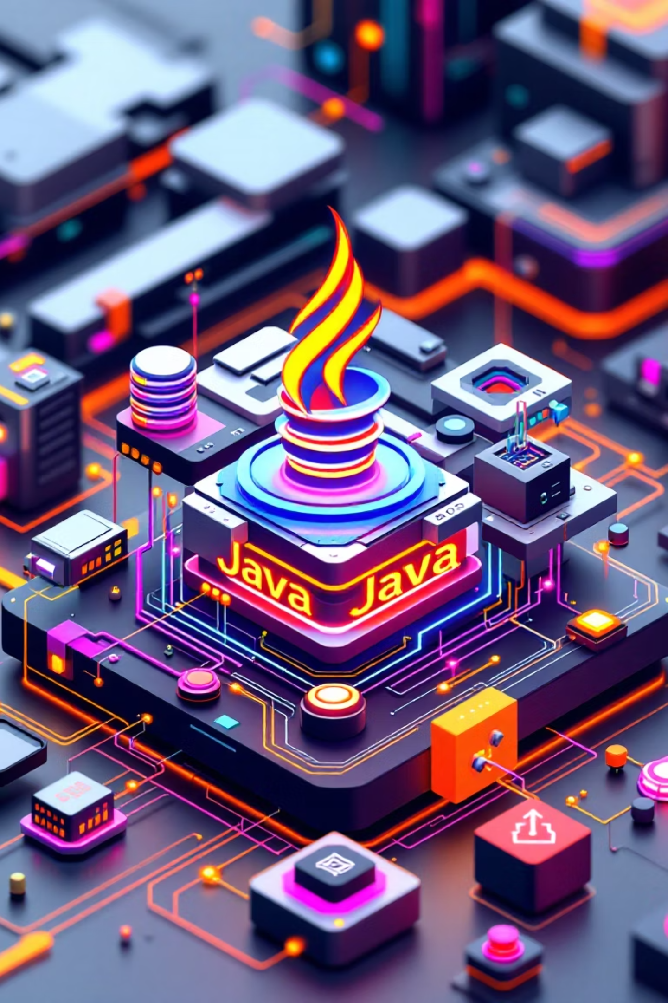

Introduction to Spring Boot Framework
Welcome to this comprehensive introduction to Spring Boot, one of the most powerful frameworks in the Java ecosystem. Today, we'll explore how Spring Boot simplifies enterprise application development while maintaining the robust features of Java.
Presented by R.a.mohan Tiwari and Namrata Bastola, this session will guide you through Java fundamentals, Spring Framework concepts, and the game-changing benefits of Spring Boot.
by Ramon

Slide 2

Java: The Foundation
1
Platform Independence
Java follows the "Write Once, Run Anywhere" philosophy through the Java Virtual Machine (JVM), allowing applications to run on any device with a JVM installed regardless of the underlying hardware.
2
Object-Oriented Design
Everything in Java is an object, enabling modular programming through classes, inheritance, encapsulation, and polymorphism that helps manage complex software systems.
3
Rich Ecosystem
Java offers a comprehensive ecosystem including JDBC for database connectivity, JavaFX for UI, Servlets for web applications, and frameworks like Spring and Hibernate for enterprise development.
Java's robust memory management with automatic garbage collection and strong security features make it ideal for enterprise applications. Its multithreaded capabilities support concurrent execution for responsive applications.

Slide 3


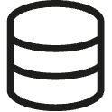
Spring Framework Overview
Core Spring Concepts
Spring Modules
Inversion of Control (IoC) - Spring manages object creation and lifecycle
Spring Core - Foundation for dependency injection
Spring MVC - Web application framework
Dependency Injection (DI) - Dependencies are injected at runtime
Spring Security - Authentication and authorization
Aspect-Oriented Programming (AOP) - Separates cross-cutting concerns
Spring Data - Data access and persistence
Web Applications
Build dynamic web applications with comprehensive MVC support
RESTful APIs
Create scalable APIs with minimal configuration
Data Access
Simplified database operations through JDBC and JPA

Slide 4
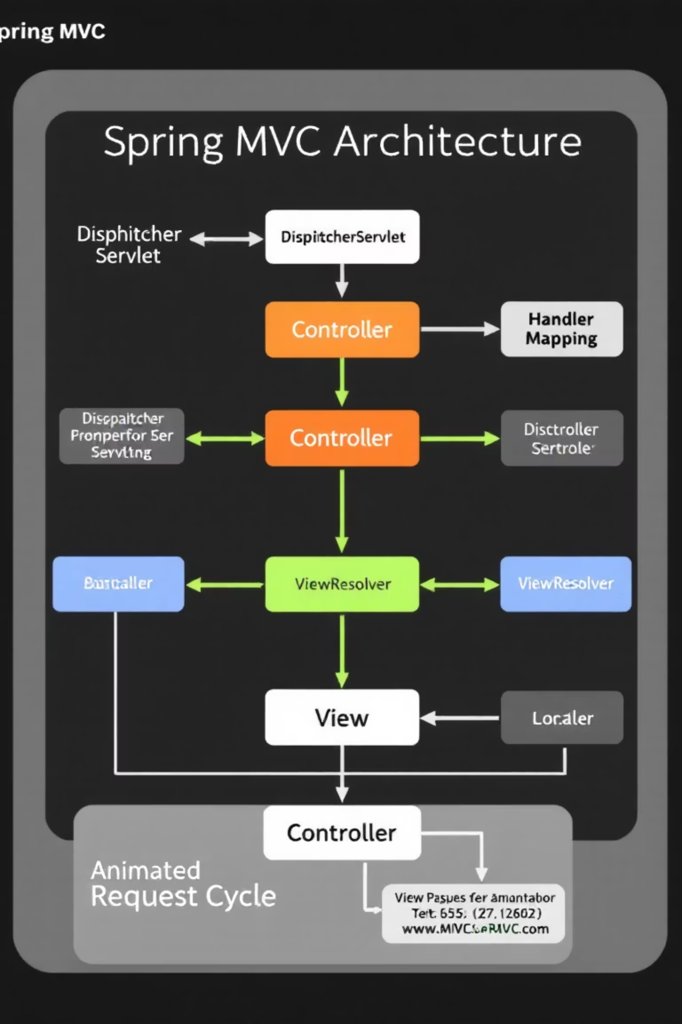



Spring MVC Architecture
Spring MVC implements the Model-View-Controller pattern to create a clean separation of concerns in web applications, making them more maintainable and testable.
Model
Represents application data and business logic that manipulates this data, independent of the user interface.
View
Displays information to users through various technologies like JSP, Thymeleaf, or React. It renders the model data and sends back HTML to the client.
Controller
Processes incoming requests, manipulates data using the Model, and determines which View should be rendered.
This architecture ensures clean separation of concerns, making applications easier to develop, test, and maintain while providing flexibility in view technologies.

Slide 5
Spring MVC Request Flow
User Request
1
Browser sends HTTP request to the application
2
DispatcherServlet
The front controller intercepts and manages all incoming requests
HandlerMapping
3
Identifies which Controller should handle the request based on URL
4
Controller Processing
Controller executes business logic and populates the Model with data
ViewResolver
5
Determines which View should render the response based on logical view name
6
View Rendering
Selected View uses Model data to generate the final HTML response
For example, when a user requests /students/list, the DispatcherServlet routes to StudentController.listStudents(), which processes the request and returns a logical view name that ViewResolver translates to list_students.html.

Slide 6
Why Spring Boot?
70%
0
Spring Boot Advantages
Auto-configuration based on project dependencies
Development Speed Increase
External Server Configuration
Starter dependencies for simplified dependency management
Spring Boot DevTools for hot reloading during development
Accelerates Java application development through auto-configuration
No need for external Tomcat/Jetty setup with embedded servers
Built-in production-ready features like health checks and metrics
Simplified deployment as standalone applications
Extensive testing support for all application layers
85%
Reduced Boilerplate
Eliminates configuration code through convention over configuration
Spring Boot transforms Spring development by eliminating most configuration work, allowing developers to focus on business logic instead of infrastructure setup.

Slide 7
Spring Boot Workflow
Project Generation
Create a new project using Spring Initializr at start.spring.io by selecting required dependencies
Add Dependencies
Include starter dependencies like spring-boot-starter-web, spring-boot-starter-data-jpa as needed for your application
Create Main Application Class
Define a class with @SpringBootApplication annotation that serves as the entry point
Develop Application Components
Create controllers (@RestController, @Controller), services (@Service), and repositories (@Repository)
Run and Test
Execute with 'mvn spring-boot:run' or 'java -jar target/app.jar' and test the endpoints
@SpringBootApplicationpublic class MyApplication { public static void main(String[] args) { SpringApplication.run(MyApplication.class, args); }}
This streamlined workflow dramatically reduces the time from concept to working application, making Spring Boot ideal for rapid development.

Slide 8





Practical Spring Boot Application Structure
1
Key Takeaways
2
Spring Boot significantly reduces development time through auto-configuration
3
The embedded server eliminates deployment complexity
Starter dependencies simplify project setup
4
Production-ready features come built-in
5
Strong community support and extensive documentation
1
Controllers
2
Services
3
Repositories
4
Domain Models
5
Configuration
Spring Boot has revolutionized Java application development by making it accessible to beginners while providing the power and flexibility needed for complex enterprise applications. Start your Spring Boot journey today!

